Slide 1
Statistics 367-1-4361 Hierarchical Models
Opher Donchin

Slide 2
8A Review

Slide 3
8B Overfitting and underfitting

Slide 4
Occam’s razor
Given two explanations that both explain the phenomena
Prefer the simpler
William of Ockham 1287-1347
English Friar and Theologian
Used the principle effectively
Attributed to him by philosophers in 1600s
Chatton’s anti-razor
Contemporary disputant of William of Ockham
If three assumptions are not enough to explain the phenomena
A fourth will be necessary

Slide 5
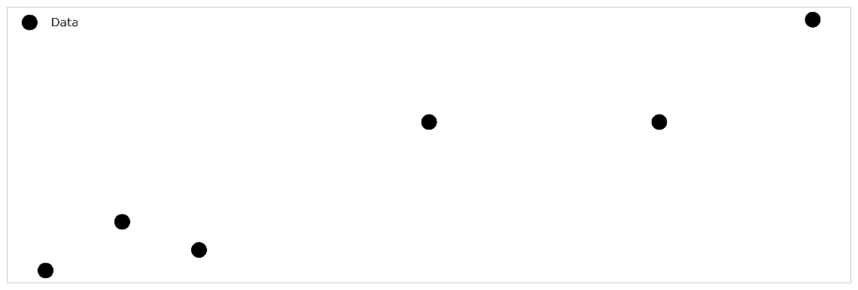
Some data

Slide 6
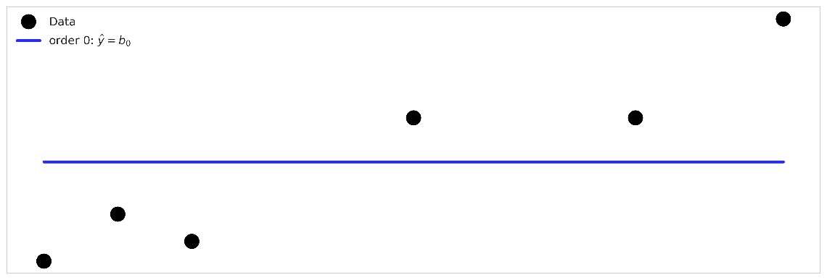
A model that underfits

Slide 7
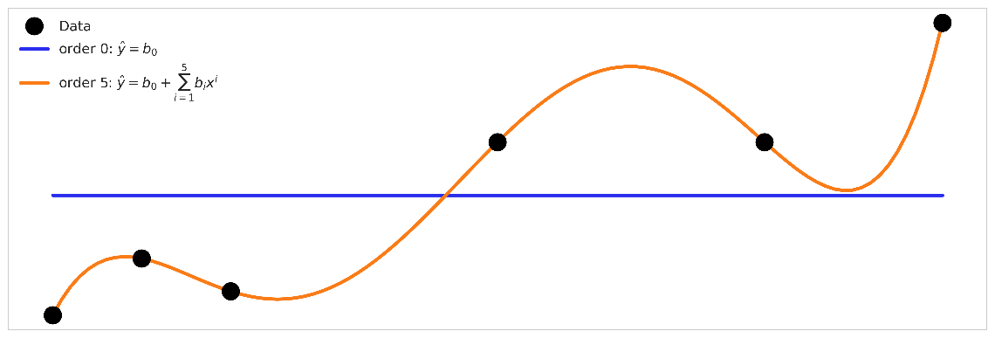
A model that overfits

Slide 8
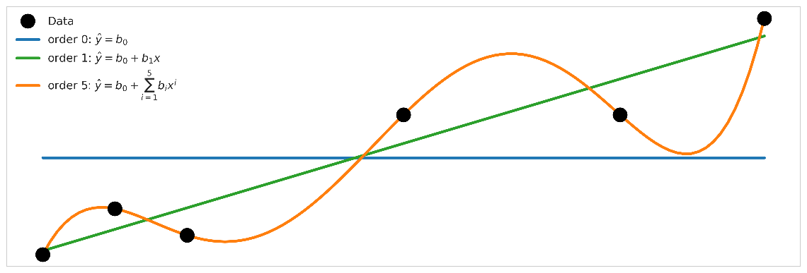
A model that balances overfitting and underfitting?

Slide 9
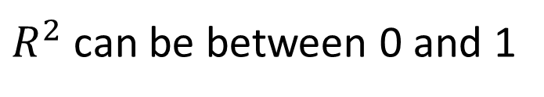
Coefficient of determination
How much the model explains
Out of how much could be explained
$R^{2}$ can be between 0 and 1

Slide 10
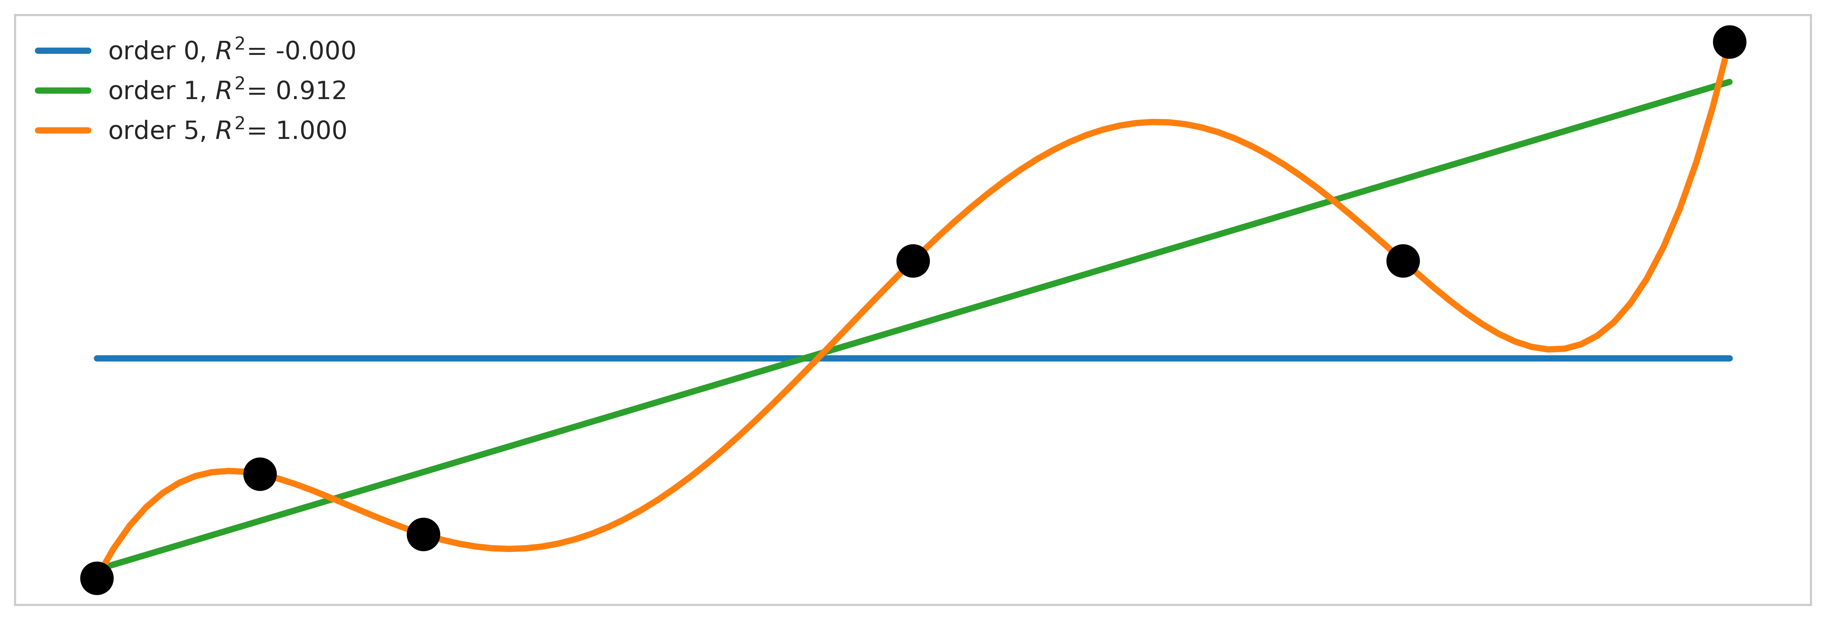
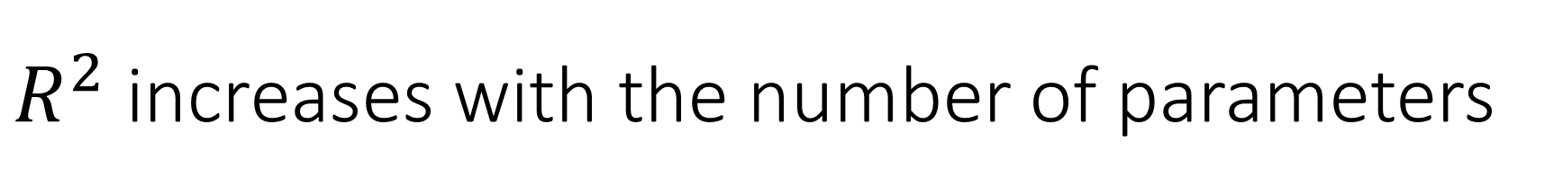
$R^{2}$ increases with the number of parameters

Slide 11
How well should a model fit?
A model that is too simple
Like a prior that is too strong
Choice of model determines results
The data doesn’t speak
A model that is too complex
Like a prior that is too weak
Results become noisy

Slide 12
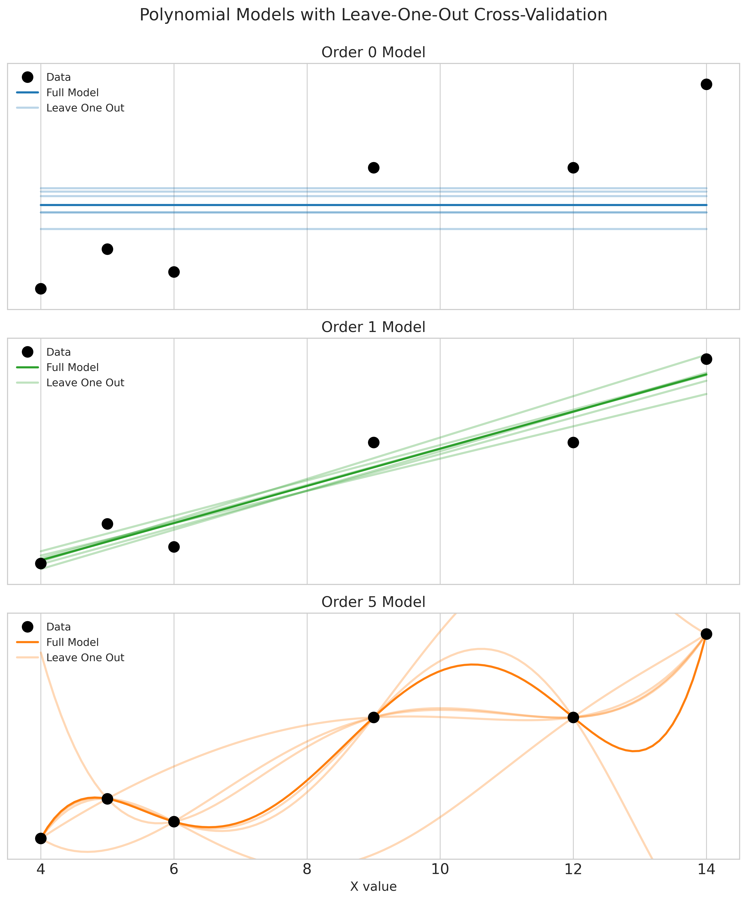
Leaving out one data point
Overfit model
Overly sensitive to data details
Underfit model
Ignores important details

Slide 13
8C What makes a good model?

Slide 14

All models are wrong
Indeed. We would not want them to be perfect!
We need them to be wrong in the right way?
On Exactitude in Science Jorge Luis Borges, Collected Fictions, translated by Andrew Hurley.
…In that Empire, the Art of Cartography attained such Perfection that the map of a single Province occupied the entirety of a City, and the map of the Empire, the entirety of a Province. In time, those Unconscionable Maps no longer satisfied, and the Cartographers Guilds struck a Map of the Empire whose size was that of the Empire, and which coincided point for point with it. The following Generations, who were not so fond of the Study of Cartography as their Forebears had been, saw that that vast Map was Useless, and not without some Pitilessness was it, that they delivered it up to the Inclemencies of Sun and Winters. In the Deserts of the West, still today, there are Tattered Ruins of that Map, inhabited by Animals and Beggars; in all the Land there is no other Relic of the Disciplines of Geography. —Suarez Miranda,Viajes de varones prudentes, Libro IV,Cap. XLV, Lerida, 1658

Slide 15

Some models are useful
So what can they be useful for?
Hypothesis testing
Prediction
Theory building
Different uses, different goals

Slide 16
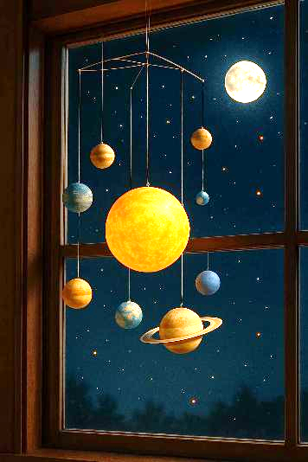
Theory building
Models underlie our understanding
Especially scientific understanding
Reflect important truths about reality
Better models reflect important parts
More faithfully
A good model must be:
Interpretable
Meaningful
Generalizable
Science is: accepting good enough models

Slide 17
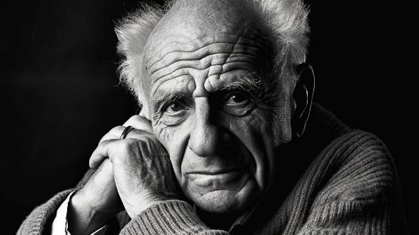
Hypothesis testing
Karl Popper The Logic of Scientific Discovery 1934
Scientific theories can’t be proven, but only falsified
Practically this lead to:
Progress through falsifying simplistic theories
Statistical tests to reject simple theories
No different / no effect / no influence
Science is: rejecting bad models

Slide 18
Prediction
Up until the 1970s
Focus on finding ‘true’ parameter values
Focus on hypothesis testing
1970s: The link through information theory
Find the model ‘closest’ to the true model
Notice connection to predictive accuracy
1980s: The prediction revolution
Mervyn Stone 1983
A.P. Dawid 1984
Under the best model, future data is likely
Science is: comparing candidate models

Slide 19
What makes a good model?
Theory building
Science is accepting good enough models
Good models explain the phenomenon
Hypothesis testing
Science is rejecting bad models
Good models are what remains after the bad ones are rejected
Predictive power
Science is comparing candidate models
Good models have better predictive power

Slide 20
8D ROPE and HDI

Slide 21
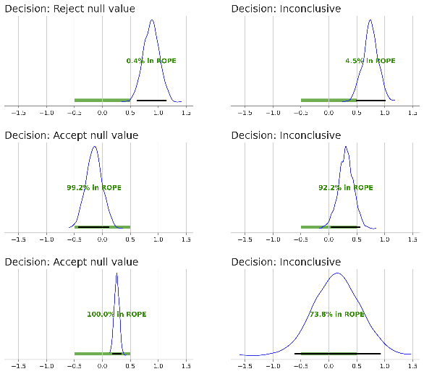
Reminder: Using the HDI and the ROPE
HDI doesn’t overlap ROPE
Reject null model
Falsified!!
Popperian hypothesis testing
HDI within ROPE
Accept null model?
Falsify vague alternative possibilities
Otherwise
Inconclusive
Get more data or rethink experiment

Slide 22
HDI and ROPE as model comparison
Compare
A model centered near the null value
All other models
If one is falsified
The other model is better
Weaknesses
Arbitrary ROPE
Arbitrary HDI width
Poorly specified alternatives
Strengths
Simple to apply
Simple to understand
Clear parallels in frequentist methods

Slide 23
What makes a good model?
Theory building
Science is accepting good enough models
Good models explain the phenomenon
Hypothesis testing
Science is rejecting bad models
Good models are what remains after the bad ones are rejected
Predictive power
Science is comparing candidate models
Good models have better predictive power
Rope and HDI

Slide 24
8E Bayes Factor

Slide 25
Bayes factor
Comparing the posterior probability of two models:
Posterior odds:
Baye’s factor is the increased probability for one model over another, ignoring prior preference.

Slide 26
The evidence
The evidence is the probability of the data (under the model)
Bayes’ Theorem:
Conditioning on the model:
The evidence:
This integral is not necessarily easy to calculate
- And it depends on the prior

Slide 27
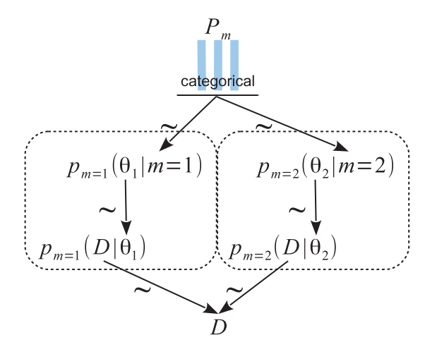

A Kruschke diagram for model selection
$P_{m}$ is the posterior probability of one of the models
Implicitly assume that $p\left(m_{1} | y\right)=1−p\left(m_{2} | y\right)$
Posterior odds:

Slide 28
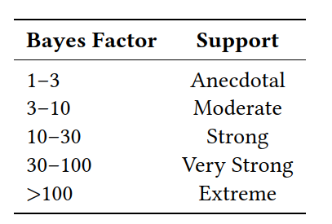
Interpreting the Baye’s Factor
Standard arrangements for the Bayes Factor
Stronger model on top
Null model on the bottom
Use a table to interpret

Slide 29
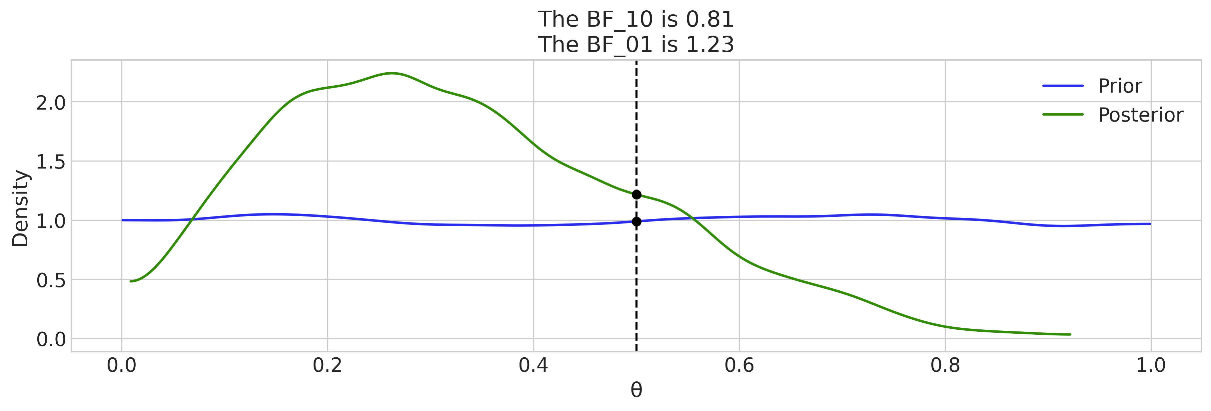
Reminder: The Savage-Dickey density ratio
Ratio of prior and posterior density at a reference value
Measures evidence in data for or against that value
az.plot_bf(idata, var_name="θ", prior=np.random.uniform(0, 1, 10000), ref_val=0.5

Slide 30
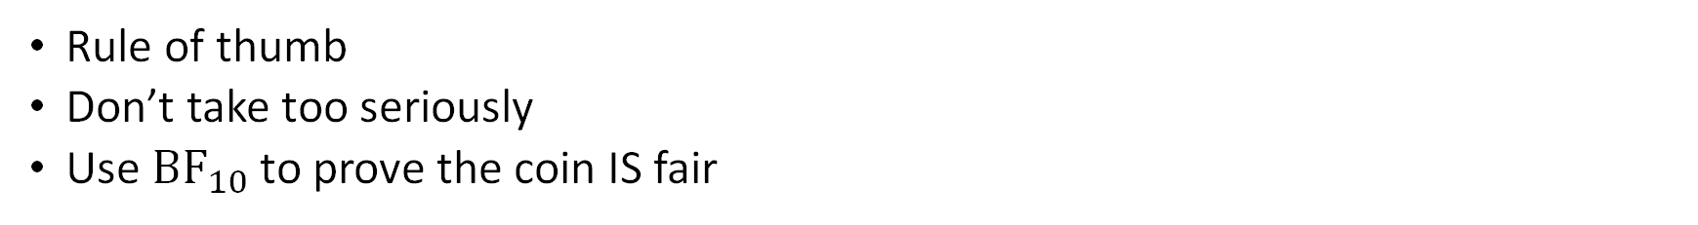
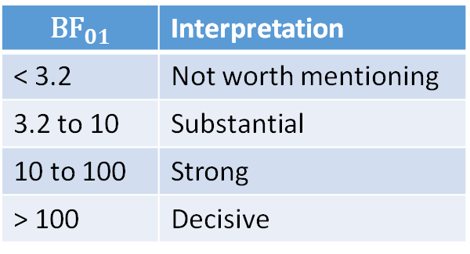
Interpreting the Savage-Dickey
Rule of thumb
Don’t take too seriously
Use ${\text{BF}}_{10}$ to prove the coin IS fair
$${\text{BF}}_{01}$$ | Interpretation
< 3.2 | Not worth mentioning
3.2 to 10 | Substantial
10 to 100 | Strong
> 100 | Decisive

Slide 31
Oppostion to the Bayes factor
Bayes factors are sometimes used to make these model comparisons, but we find them generally to be irrelevant because they compute the relative probabilities of the models conditional on one of them being true.
We prefer approaches that measure the distance of the data to each of the approximate models.

Slide 32
Points about Bayes factors
Actually getting these models to run is hard
More data -> larger Bayes factor
With enough data one model is always better
Bayes factor only meaningful if one model is the true model
Which is never true

Slide 33
What makes a good model?
Theory building
Science is accepting good enough models
Good models explain the phenomenon
Hypothesis testing
Science is rejecting bad models
Good models are what remains after the bad ones are rejected
Predictive power
Science is comparing candidate models
Good models have better predictive power
Baye’s Factor
Rope and HDI
Baye’s Factor

Slide 34
8F The True Model

Slide 35
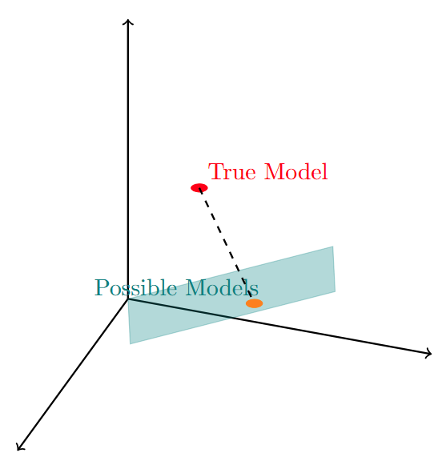
We don’t have the true model
Hypothesis testing assumes one mode might be true
Either the null model is true or an alternative
But we know that all models are false
Maybe the best model is the one closest to the truth

Slide 36
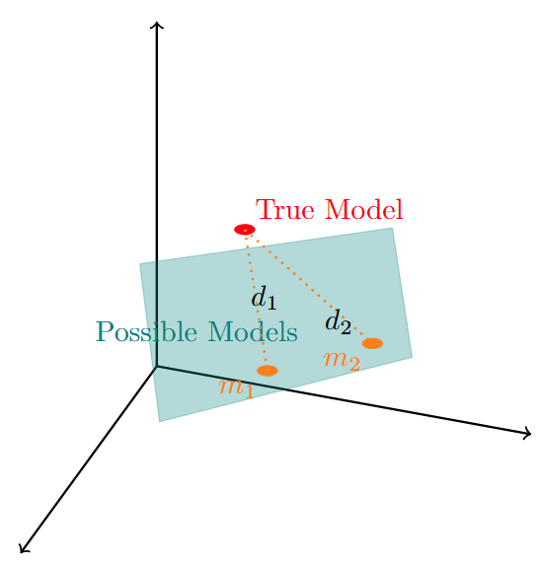
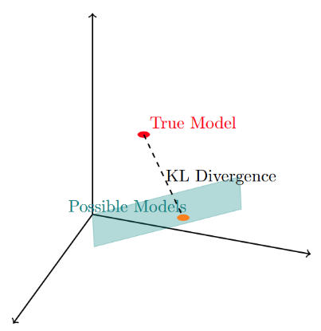
A distance measure might help
A distance measure might
Give the distance from the true model
Allow comparison between models
Can we measure distance from the true model?
By using new data
New data comes from the true model

Slide 37
A measure of distance between models
The Kullback-Leibler divergence
The added “entropy” from using the wrong distribution
The cross entropy minus the entropy

Slide 38
8G Entropy and uncertainty

Slide 39
What is entropy?`
A measure of disorder
So: a measure of uncertainty
Two key applications of entropy:
The temperature of a system in physics
More disordered means more movement of the particles
Information in computer science
The number of bits needed to store information in computer

Slide 40
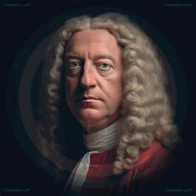
A brief history of entropy
Bernoulli 1738
Mathematical genius from a family of geniuses
Kicked out of the house by his dad
Because dad was jealous of a math prize Bernoulli won
Gas pressure is microscopic particles colliding with the container
Kinetic energy of particles determines temperature

Slide 41
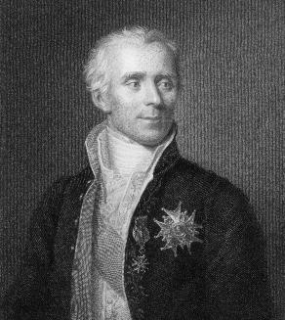
A brief history of entropy
Bernoulli 1738
Gas pressure is microscopic particles colliding with the container
Laplace 1812
Napoleon’s minister of the interior
Used Bayesian inference before Bayes
Why does time have an arrow?
Why does temperature equalize and not diverge?
Why does gas spread out in a room?

Slide 42
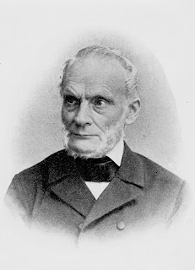
A brief history of entropy
Bernoulli 1738
Gas pressure is microscopic particles colliding with the container
Laplace 1812
Why does time have an arrow?
Classius 1850
Invented entropy at a drinking party when someone complained about the beer getting warm
Temperature is not symmetric
Energy flows spontaneously from hotter body to colder one
Entropy is Greek for “the direction things go”
Energy becoming entropy can be used for work

Slide 43
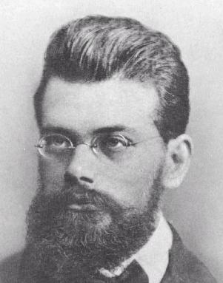
A brief history of entropy
Bernoulli 1738
Gas pressure is microscopic particles colliding with the container
Laplace 1812
Why does time have an arrow?
Classius 1850
Temperature is not symmetric
Boltzman 1870
Specified that his equation should be engraved on his tombstone
Entropy measures the number of micro-states available to the particles
Particles arrange themselves at random into micro-states
Macro-states with more micro-states are more probably
Statistical mechanics:
Properties of matter derived from probability and counting

Slide 44
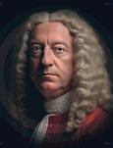
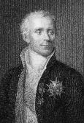

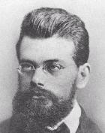
A brief history of entropy
Bernoulli 1738
Gas pressure is microscopic particles colliding with the container
Laplace 1812
Why does time have an arrow?
Classius 1850
Temperature is not symmetric
Boltzman 1870
Entropy measures the number of micro-states available to the particles
Macro-states with more micro-states are more probable
Statistical mechanics

Slide 45
From entropy to information
Josiah Willard Gibbs 1870
Deal with the probability distribution and not the particles
Uncertainty and disorder can be quantified
James Clerk Maxwell 1870
Information processing can reduce entropy
John Von Neumann 1930
Extend entropy to quantum mechanics
Uncertainty about a particle is measured as entropy
Claude Shannon
Information in a message is reduction in entropy

Slide 46
What is entropy?
Three concepts of entropy
The number of possible states
The uncertainty about the state
The information from learning the state
For all three: the entropy of two separate systems should be additive

Slide 47
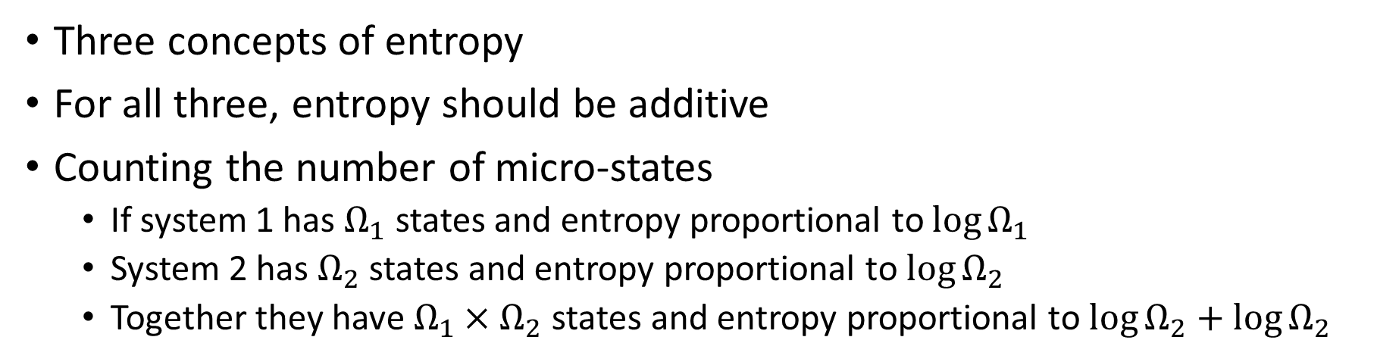
What is entropy?
Three concepts of entropy
For all three, entropy should be additive
Counting the number of micro-states
If system 1 has $Ω_{1}$ states and entropy proportional to $\log{Ω_{1}}$
System 2 has $Ω_{2}$ states and entropy proportional to $\log{Ω_{2}}$
Together they have $Ω_{1}×Ω_{2}$ states and entropy proportional to $\log{Ω_{2}+\log{Ω_{2}}}$

Slide 48
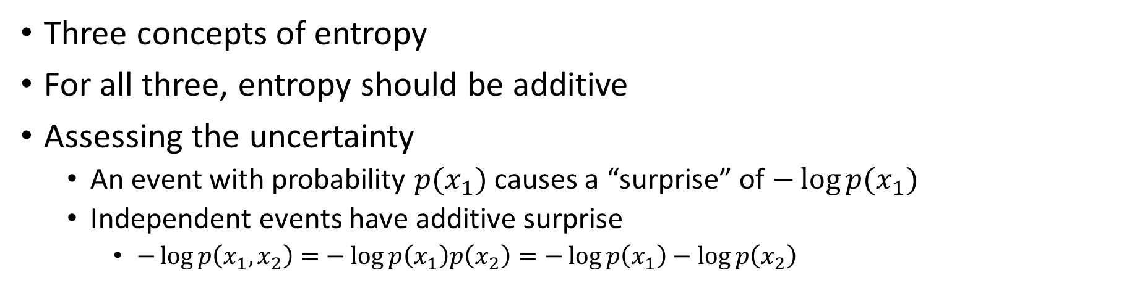
What is entropy?
Three concepts of entropy
For all three, entropy should be additive
Assessing the uncertainty
An event with probability $p(x_{1})$ causes a “surprise” of $−\log{p(x_{1})}$
Independent events have additive surprise
$−\log{p\left(x_{1},x_{2}\right)=}−\log{p\left(x_{1}\right)p\left(x_{2}\right)}=−\log{p\left(x_{1}\right)−\log{p\left(x_{2}\right)}}$

Slide 49
8H Cross-entropy

Slide 50
Sometimes we don’t know the true distribution
Our surprise comes from our (wrong) assessment
Our expected surprise is averaged over the true distribution

Slide 51
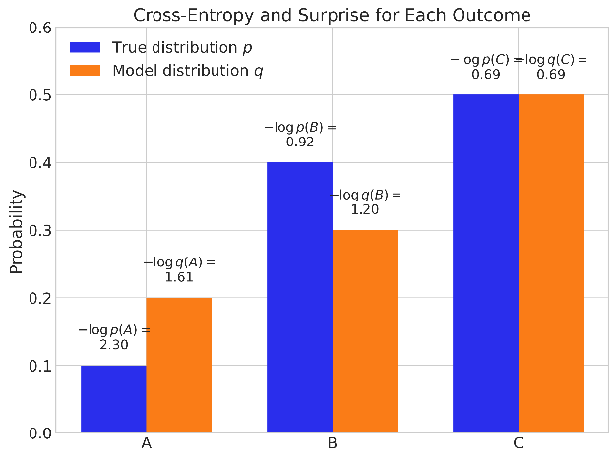
The cross-entropy
The cross-entropy is the expected surprise for the wrong distribution
The cross-entropy is always larger than the entropy
Being wrong means being more surprised

Slide 52
The cross-entropy
The cross-entropy is the expected surprise for the wrong distribution
The cross-entropy is always larger than the entropy
Being wrong means being more surprised

Slide 53
Kullback-Leibler Divergence
The difference between the cross entropy and the entropy
The added uncertainty of using the wrong model
An (asymmetric) measure of distance between two distributions

Slide 54
8I Distance from the true model

Slide 55
In our case: the model from the truth
The distance of the model’s distribution from the true data distribution
The true likelihood vs the posterior predictive likelihood
Here $y$ means the probability density of data, not the specific data we collected.

Slide 56
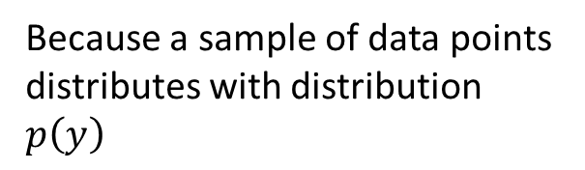

The score
Part of this we can estimate from data
${\tilde{y}}_{i}$ means an $i$-th actual new data point
Because a sample of data points distributes with distribution $p\left(y\right)$
The score

Slide 57
Calculating the score
Needs to be averaged over the posterior distribution under the model
Often people calculate deviance instead of score but it’s the same

Slide 58
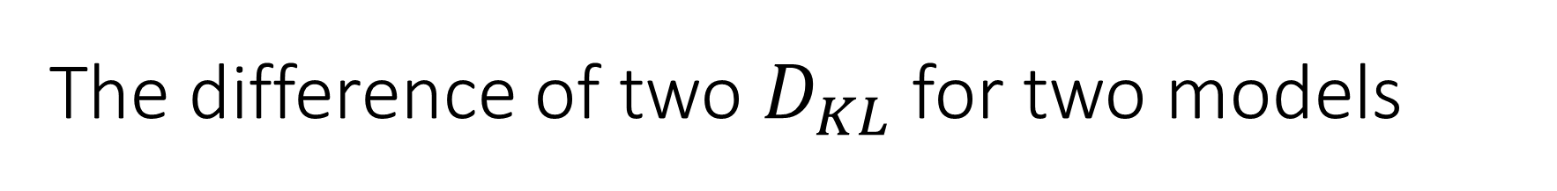
The difference of two $D_{KL}$ for two models
Is the difference of their scores!

Slide 59
To compare models we calculate the score
Each score is meaningless, only the comparison matters
Cannot be actually calculated on existing data

Slide 60
8J Information criteria

Slide 61
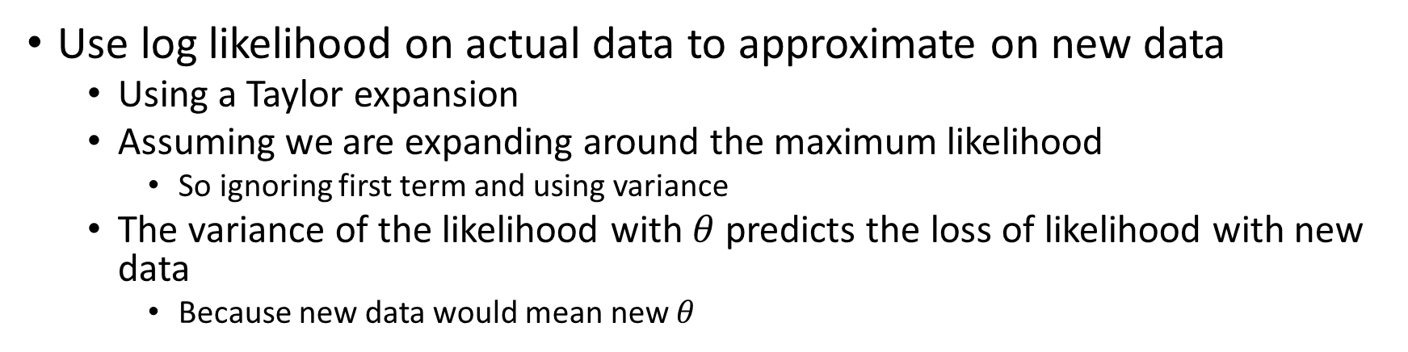
Information criteria approximate the score
Use log likelihood on actual data to approximate on new data
Using a Taylor expansion
Assuming we are expanding around the maximum likelihood
So ignoring first term and using variance
The variance of the likelihood with $θ$ predicts the loss of likelihood with new data
Because new data would mean new $θ$

Slide 62
Many Information Criteria
Akaike Information Criterion (AIC)
Used in frequentist analysis to compare models
Counts parameters to estimate variance of the likelihood
Bayesian Information Criterion (BIC)
Used to approximate Bayes factor
Deviance Information Criterion (DIC)
Formerly standard in Bayesian analysis
Widely Applicable Informaiton Criterion (WAIC)
Available in Stan and Arviz

Slide 63
WAIC
Predicts the score on new data
Used to compare distance to the true model across models
The smaller WAIC is the better model

Slide 64
8K Cross Validation

Slide 65
What makes a good model?
Theory building
Science is accepting good enough models
Good models explain the phenomenon
Hypothesis testing
Science is rejecting bad models
Good models are what remains after the bad ones are rejected
Predictive power
Science is comparing candidate models
Good models have better predictive power
Baye’s Factor
WAIC
Rope and HDI
Baye’s Factor

Slide 66
Predictive power
Sometimes the “true model” isn’t important or interesting
We only care about predictive power
The ability of the model predict new data
WAIC estimates the ability to predict new data
Testing the model on new data is called validation

Slide 67
Validation and cross-validation
Strategies for validation
True validation
Go out and collect a new data set
Withheld data
Divide data into train and test
Sometimes into train, test, and validate
Cross-validation
Train on subsets of data
Test on others
Repeat over subsets
True validation is expensive and time consuming
Withheld data is vulnerable to leakage
There is a bias variance tradeoff
Cross-validation requires multiple model fits

Slide 68
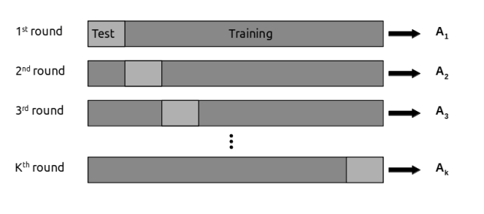
K-fold cross-validation
Divide the data into k chunks
For each chunk
Fit model to the rest of the chunks
Evaluate log likelihood on that chunk
Average predictive ability across chunks
Widely used in machine learning
Problematic in Bayesian analysis
Because fitting models is expensive

Slide 69
Leave-one-out Cross Validation (LOO-CV)
Make N chunks of size 1
But approximate instead of refitting the model
Expected log predictive density

Slide 70
We need a trick to evaluate the integral
We are taking the integral over the wrong probability
This trick is called importance sampling
If we had
We would write
Now we have
So we can write

Slide 71
What is the importance sampling ratio?
Because the ratio of the evidence is constant, we drop it.
We normalize the weights in any case

Slide 72
Importance sampled LOO-CV
This approximates the expected log likelihood of new data

Slide 73
The problem with importance sampling
In importance sampling
You sample the proposal distribution instead of the target distribution
And then weight the samples according to the ratio
This has a problem if the importance weight is too large

Slide 74
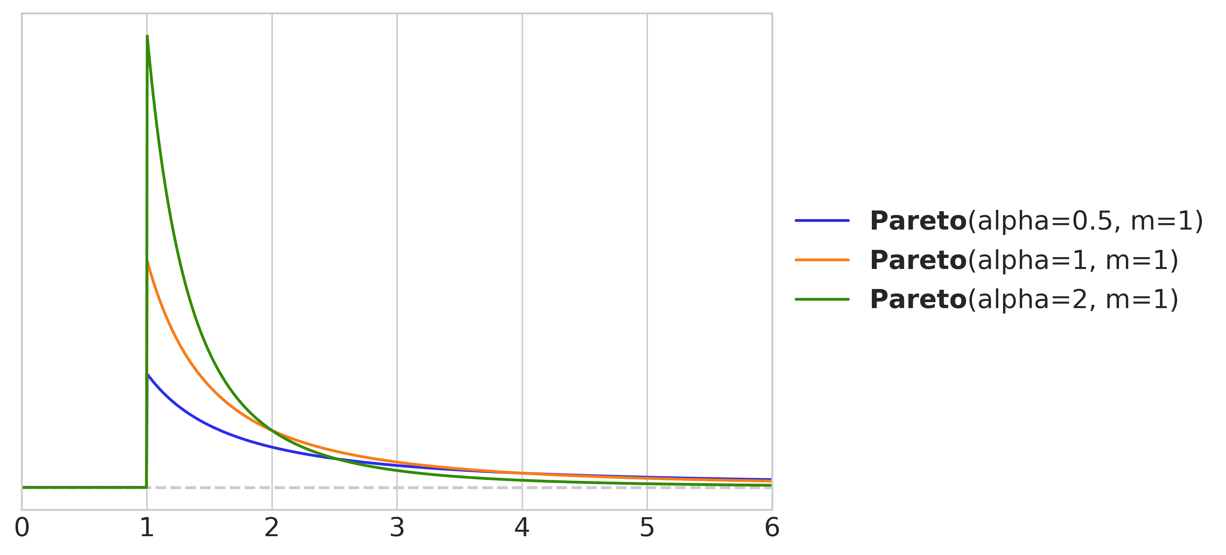
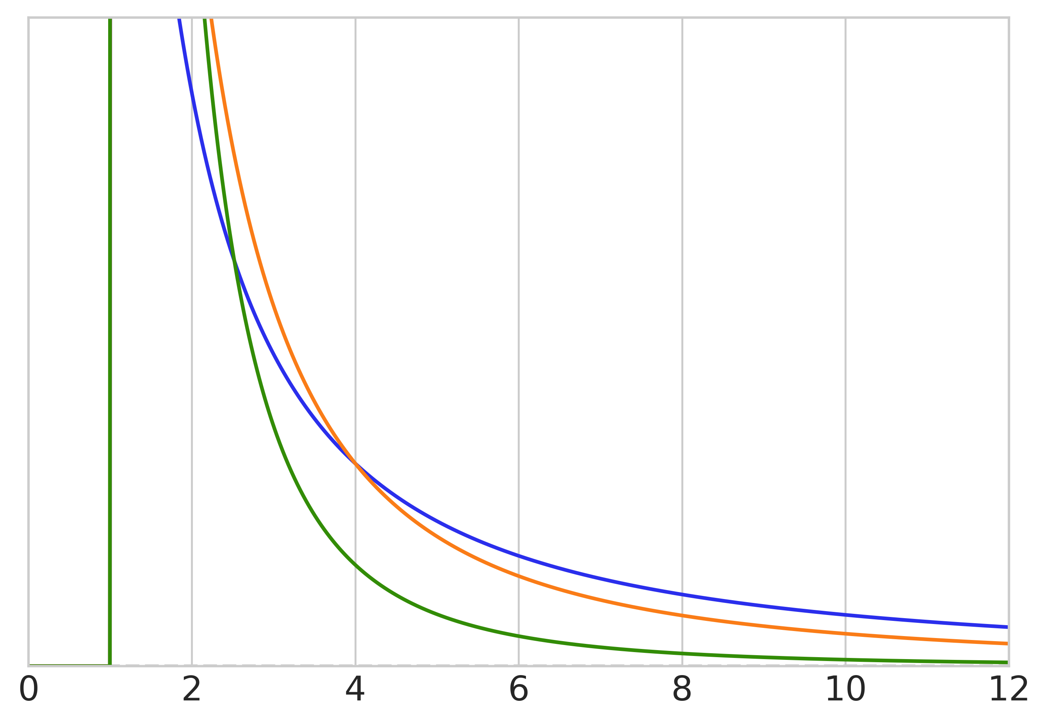
Pareto smoothing
The Pareto distribution has wider tails
Like the Student’s t distribution
But much wider
Replace extreme weights (usually top 20%)
Using Pareto distribution fit to the rest of the weights
Unreliable if shape parameter > 1!

Slide 75
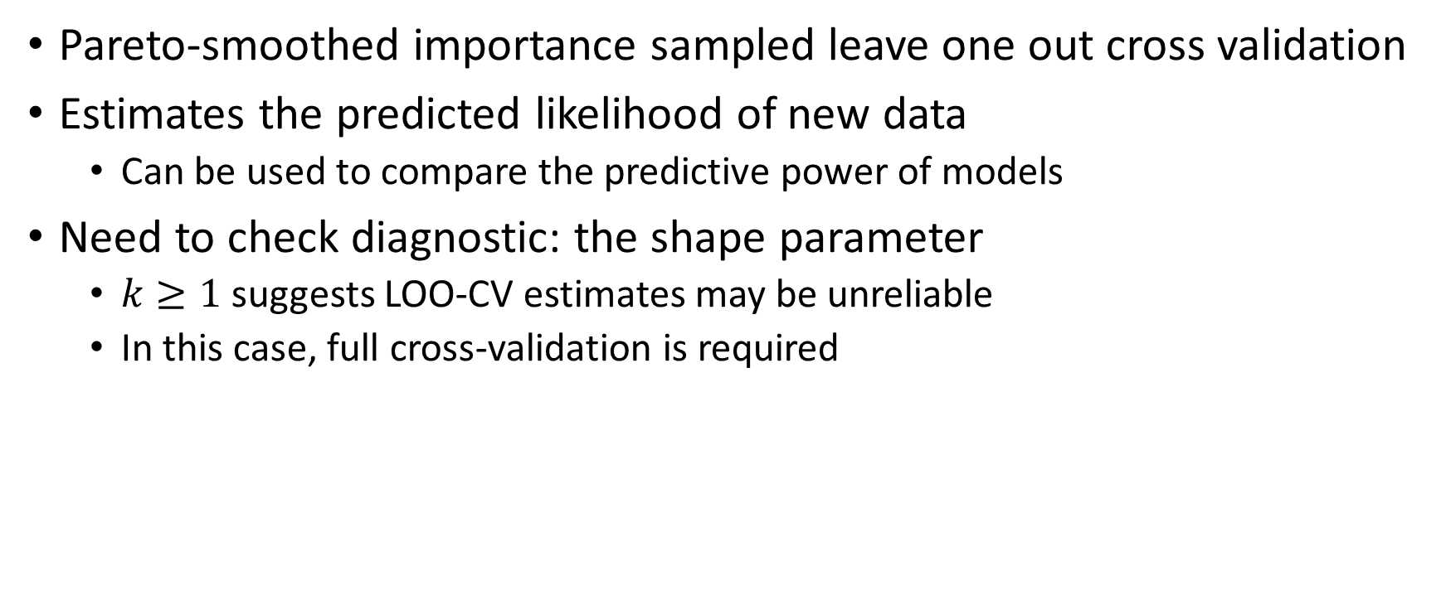
PSIS LOO-CV
Pareto-smoothed importance sampled leave one out cross validation
Estimates the predicted likelihood of new data
Can be used to compare the predictive power of models
Need to check diagnostic: the shape parameter
$k≥1$ suggests LOO-CV estimates may be unreliable
In this case, full cross-validation is required

Slide 76
What makes a good model?
Theory building
Science is accepting good enough models
Good models explain the phenomenon
Hypothesis testing
Science is rejecting bad models
Good models are what remains after the bad ones are rejected
Predictive power
Science is comparing candidate models
Good models have better predictive power
Baye’s Factor
WAIC
Rope and HDI
Baye’s Factor
PSIS LOO-CV
WAIC

